Slide 1
PAWSystem
updated as of 25 Feb 2020 @1730 hrs

Slide 2
Solution Scoping
Pet Grooming Service (PawSystem)
2 Actors: Customer (with pet), Service Provider.
5 User Scenarios
Customer manage Booking
Service Provider manage Booking
Customer creates Review
Customer makes Payment
Service Provider acknowledges Payment

Slide 3
Potential Challenges
Using Facebook API login. Customers not willing to use Facebook or not using Facebook to login.
Popular payment gateways API not available for public use.
Slots are all full for that service provider and not willing to find another service provider.
If we use different programming languages, how do we run the application as a microservice?

Slide 4
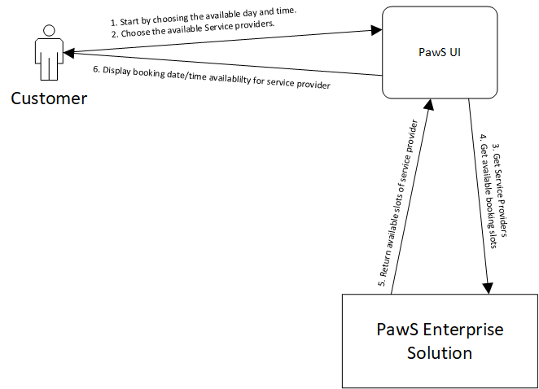
Scenario Overview Diagram - Customer manages booking
Notes:
Draw this first to get an overview of your scenario, worry about the actual implementations as you go along.
Taxi Booking Enterprise Solution will be implemented using microservices architecture comprising a number of microservices and some external services.
There can be two user interactions here:
Start to book a ride Provides the pickup location & destination in order to get the price of this booking request.
Book for a ride After seeing the price, if the passenger wants to go ahead, use the UI to click on a Book button to send the request

Slide 5
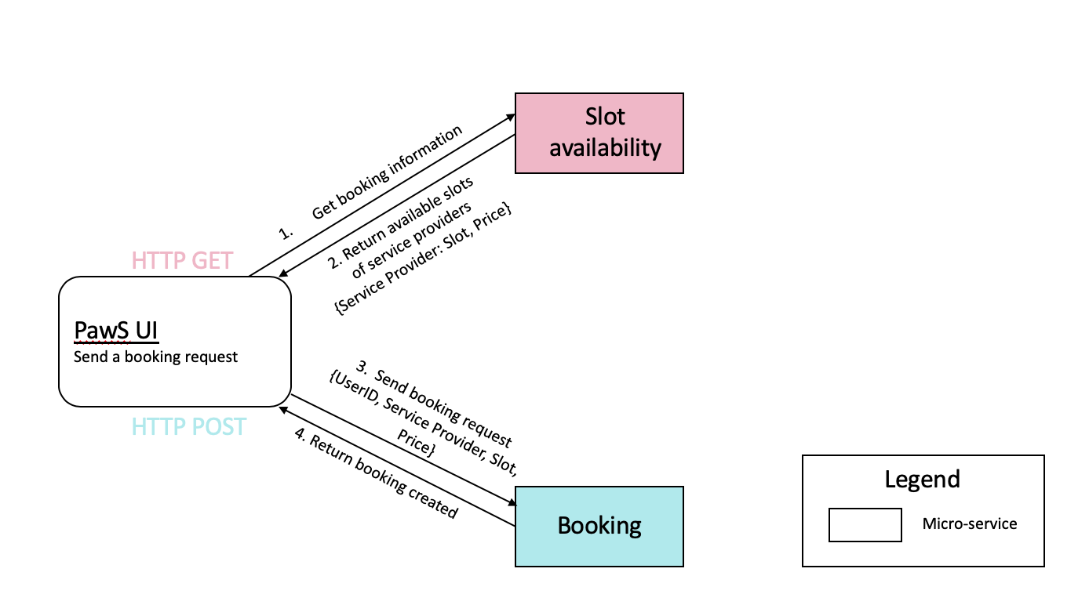
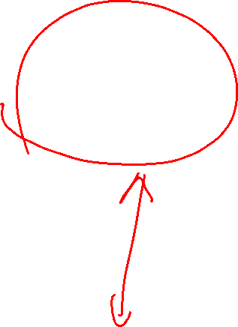
User creates booking

Slide 6
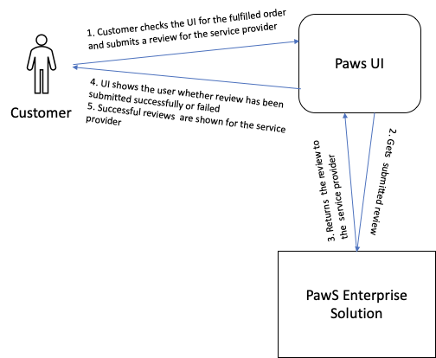
Scenario Overview Diagram - Customer Creates Review

Slide 7
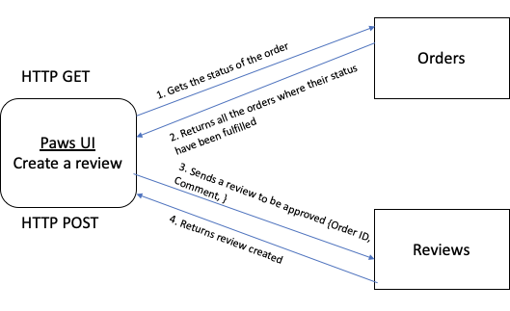
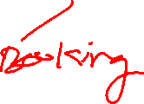
Scenario Overview Diagram - Customer Creates Review

Slide 8

Sample Scenario Overview Diagram – Customer makes payment
1. Check the price of booking
4. making payment
2. Check booking confirmation from booking microserviser {bookingID}
HTTP
Customer UI
3. Return booking’s information
Customer
6. Display payment status
AMQP
4. external payment services received payment
5. Return payment status
Booking
External payment service
Notes:
Customer makes payment to service provider:
Request price from customer UI
Check booking confirmation from booking microserviser
booking microserviser returns booking information with price
customer make payment on external payment services in Customer UI
external payment services received payment and reply payment status
customer UI display booking payment status
There may be one user interaction here:
Check the status of a booking request Passenger use the UI to check the status of the booking request. If the booking is confirmed, the UI will invoke another service to obtain the driver’s information. If the booking is still waiting for confirmation, UI will show that it is still waiting for a driver to take up this job.

Slide 9
Sample User Scenario Diagram – Service Provider Collects Payment
Service Provider UI
HTTP
2. UI returns back the payment confirmation to customers
3. Send an invoice to the customer
Customer
Process the payment information and reflect on UI
External payment service
Notes:
1. payment receives from customers?
2. UI returns back the payment confirmation to customers
3. (probably) sent an invoice to the customer
4. (external service) bank deduct money from customer’s bank acc

Slide 10
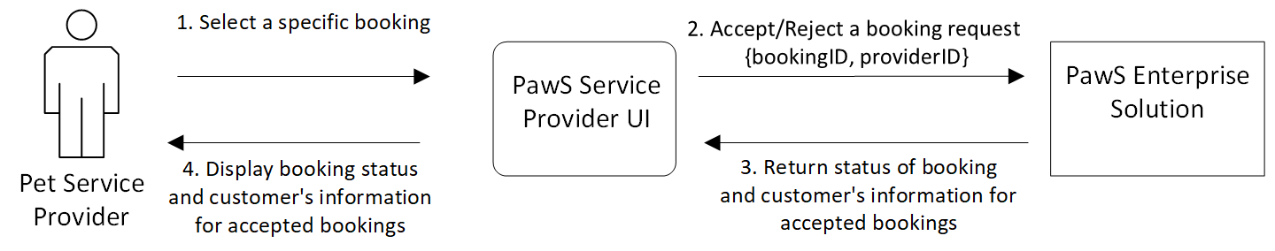
Sample Scenario Overview Diagram – Service Provider Accepts/Reject Booking

Slide 11
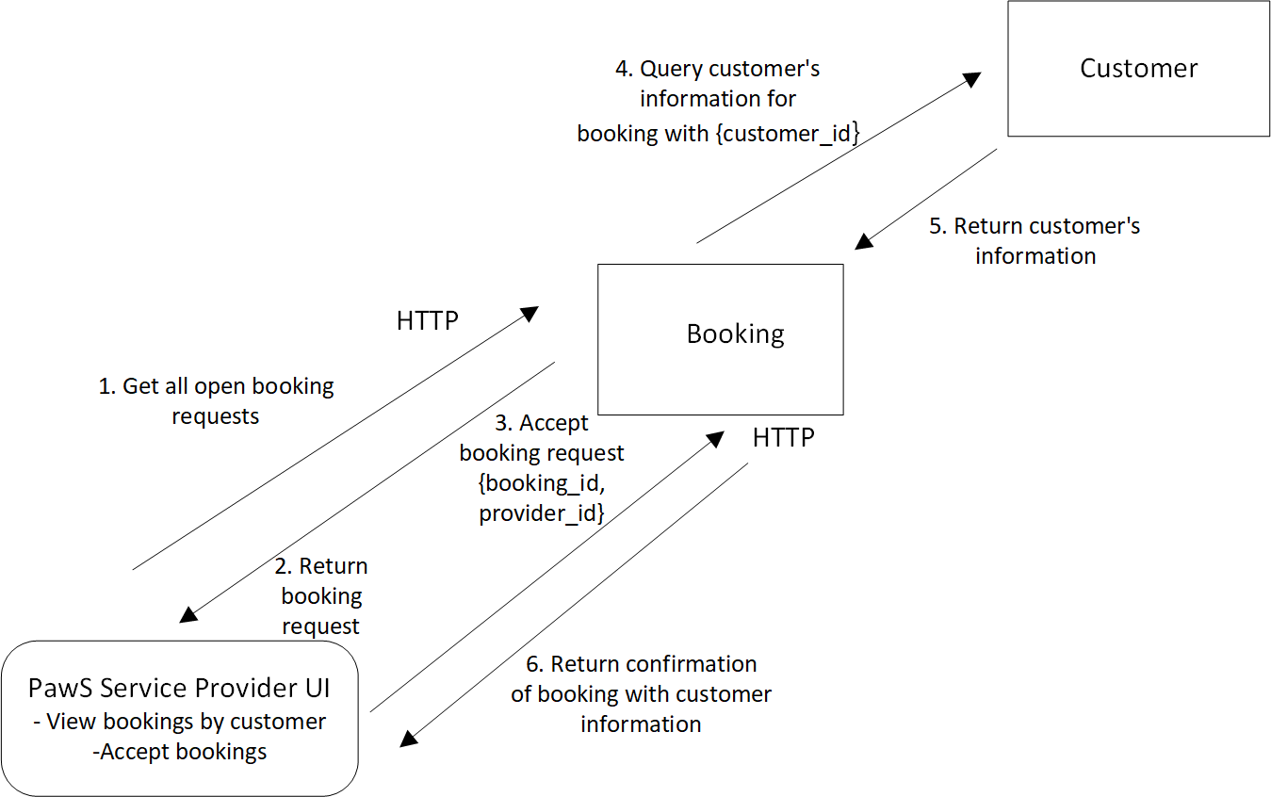
Sample User Scenario Diagram – Service Provider Accepts/Reject Booking

Slide 12
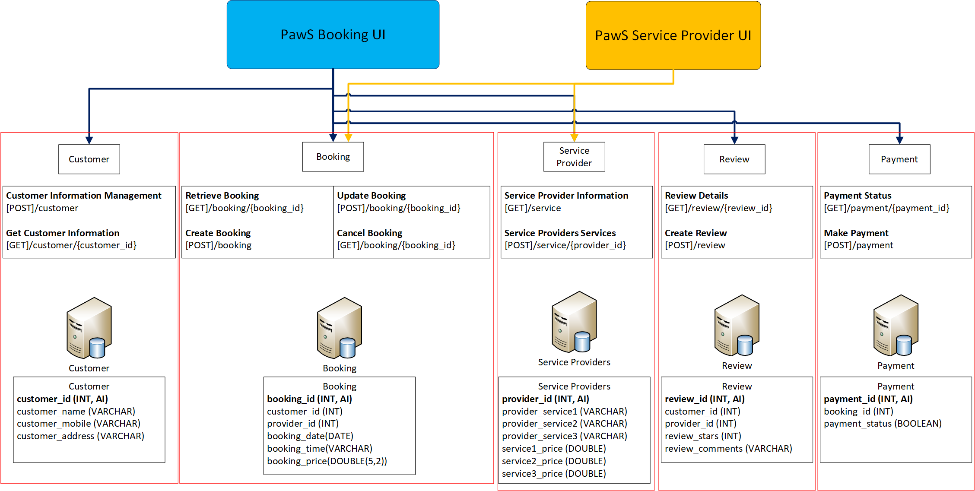
Technical Overview Diagram
Notes:
This is an overall showing the needed (micro)services in the scenario and possible implementation details.
It is good to fill this in with as many details as possible to plan your implementation, and observe the dependency between the UI to the (micro)services.

